Slide 1
Name
University afflation
Date

Slide 2
INTRODUCTION
Obesity is a global pandemic that is mostly driven by the changes in terms of food supply. There is an increase in the availability of cheap and processed foods. Such kind of foods cause cravings resulting into over eating and obesity leading to failure of processes of homeostatic that are responsible in regulating of nutritional diversity as well as energy balance.

Slide 3
What was being tested
Studies have illustrated that a high consumption of foods which are poor in nutrition i.e. junk food could result into deficits in terms of understanding as well as behavior control. We then tried to find out whether a long term intake of junk food would disrupt the rat’s capability of making adaptive choices on the basis of the reward value expectations and expectations of the cue-evoked reward.

Slide 4
Subjects and apparatus
Adult rats aged eight weeks at the time of food restriction period were secluded in a house during the experiment. During behavioral training, the Sprague-Dawley rats had to be restricted to about 85% of their free feeding mode. The behavioral training was conducted at the Med Associates where by every chamber had two retractable levers, audio generator, dispenser pellet whose purpose was to deliver chocolate pellets as well as white noise generator.

Slide 5
Methods
Different methods were used in the study they include:
Pavlovian Conditioning
Instrumental Training
Junk-Food Diet
Outcome Devaluation Testing

Slide 6
Pavlovian Conditioning
Rats under experiment received eight sessions of the Pavlovian conditioning, where by the clicker was paired with the pellets made from chocolate while the white noise with SCM. Half of the rest of the subjects in consideration received an exact opposite of the stimulus. Every session was composed of eight trials. Duration for every trial was two mins and a variable of five minutes interval separated each trial.

Slide 7
Instrumental Training
The subjects underwent eleven days of instrumental training with two sessions being done on a daily basis. During the two sessions, rats were trained that the moment they press the lever, the pellet would be delivered, that is pressing the right lever would deliver pellets while the left one would deliver SCM. In the first 2 days, there was the reinforcement of the lever presence response with the outcome of the right food. It was then adjusted to the random rations ranging from (RR-5) for the third and fourth day and RR-10 for the fifth and sixth day while RR-20 for the ninth and eleventh day.

Slide 8
Junk-Food Diet
Rats were allocated one of the available 3 diet groups. They included, the controls, intermittent as well as ad libitum. The rats being experimented had access to both chow and water while in cages. Junk foods of various types such as kit Kats, Oreo cookies , hot dogs and Hershey’s chocolate were made available on a daily basis. The rats under study were exposed to the new diet for a period of six weeks and then they were introduced to a fourteen hour access to chow from the lab in order to sustain the mild food deprivation to be used for behavioral testing.

Slide 9
Outcome Devaluation Testing
After a period of three days of food restriction, the rats were subjected to 2 sessions for testing the devaluation outcome. The evaluation was to determine the extend to which the diet exposure influenced the capability of the rat to adapt to their preferences between the action of food seeking after having been stuffed between the two food choices. The rats were given an access to the pellets made of chocolate as well as SCM for a period of 1 hour after being caged and provided with water ad libitum. The procedure was intended to decrease the rat’s incentive to food in other words (devaluing) while at the same time making sure that the incentive value for the alternative food is not affected.

Slide 10
Data Analysis and Statistics
Since the rats had been pair caged while in phase of being exposed with junk food, their food intake was monitored on the basis of per cage. The consumption of food in a day was divided by the weight of the rats in (kg). Calories from the food fed on( pellets and SCM) before the devaluation outcome undergo analysis in terms of kCal and divided by the weight of the rat in kilograms. The PIT test was arrived at by averaging the trials. All data obtained were analyzed by use of SPSS and then expressed on the basis of ± mean standard error.

Slide 11
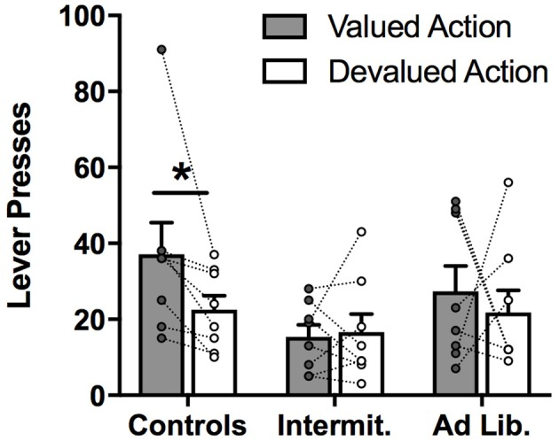
Devaluation test outcome
view" is an article written by Wolpert L.
Shows that rats pressed more on valued lever when compared to devalued one

Slide 12
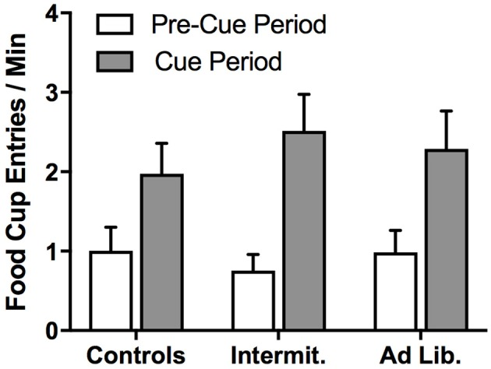
FOOD CUP DURING PIT TEST
The diet had no effect on the cup method in response to cues

Slide 13
RESULTS
Report indicates that the exposure of junk food to rats has an impaired the rats ability to adjust in terms of food seeking activities while responding to the devaluation that was induced. The findings shows that when rats have a repeated access to the kinds of diet in the study, it results into changes in term of their behavioral control that might lead to obesity as well as overeating. The findings also found out that junk foods might result into a dysregulation.

Slide 14
References
Winocur G, Greenwood CE. The effects of high fat diets and environmental influences on cognitive performance in rats. Behav Brain Res. (1999) 101:153–61. doi: 10.1016/S0166-4328(98)00147-8
Fedoroff I, Polivy J, Peter Herman C. The specificity of restrained versus unrestrained eaters' responses to food cues: general desire to eat, or craving for the cued food? Appetite (2003) 41:7–13. doi: 10.1016/S0195-6663(03)00026-6
Meule A, Lutz APC, Vögele C, Kübler A. Impulsive reactions to food-cues predict subsequent food craving. Eat Behav. (2014) 15:99–105. doi: 10.1016/j.eatbeh.2013.10.023
Jansen A, Havermans RC, Nederkoorn C. Cued overeating. In: V. R. Preedy, R. R. Watson, C. R. Martin, editors. Handbook of Behavior, Food and Nutrition. New York, NY: Springer New York (2011). p.1431–43.
Fedoroff IC, Polivy J, Herman CP. The effect of pre-exposure to food cues on the eating behavior of restrained and unrestrained eaters. Appetite (1997) 28:33–47. doi: 10.1006/appe.1996.0057
Rescorla RA. Control of instrumental performance by Pavlovian and instrumental stimuli. J Exp Psychol Anim Behav Process(1994) 20:44–50. doi: 10.1037/0097-7403.20.1.44
Rescorla RA, Solomon RL. Two-process learning theory: relationships between Pavlovian conditioning and instrumental learning. Psychol Rev. (1967) 74:151–82. doi: 10.1037/h0024475

